Slide 1
Realism (1865-1915)
English III

Slide 2
Historical Context
United States grew rapidly after the Civil War
increasing rates of democracy and literacy
rapid growth in industrialism and urbanization
expanding population base due to immigration
a relative rise in middle-class affluence
Civil War brings demand for a “truer” type of literature that does not idealize people or places
readers interested in understanding rapid shifts in culture.
During this time, people in society were defined by “class”; materialism
Reflect ideas of Darwin (survival of the fittest) and Marx (how money and class structure control a nation)

Slide 3
Genre/Style Realism
A reaction against romanticism; told it like it was
Focus on lives of ordinary people; rejected heroic and adventurous
Anti-materialism; rejected the new “class” system
View of nature as a powerful and indifferent force beyond man’s control

Slide 4
Genre/Style Naturalism
A movement much like realism but a darker view
The universe is unpredictable
Fate is determined by chance
Free will is an illusion
Characters’ lives shaped by forces they can not understand or control

Slide 5
Genre/Style
Novels, short stories
Often aims to change a specific social problem
Dominant themes: survival, fate, violence, nature as an indifferent force

Slide 6
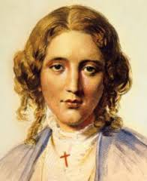
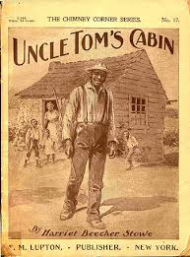
Major Writers: The Civil War
Harriet Beecher Stowe (1811-1896)
The utmost famous woman of her day
Uncle Tom’s Cabin
The most influential book of the 19th century
1st book to sell 1 million copies
One of the most effective documents of propaganda
Helped fuel the Civil War

Slide 7
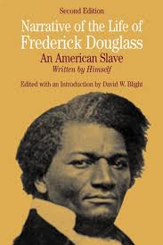
Major Writers: The Civil War
Frederick Douglass (1817-1895)
An escaped slave
One of the most effective orators of his day
Influential newspaper writer
Militant abolitionist; diplomat
Autobiography an instant and enduring classic of courage

Slide 8
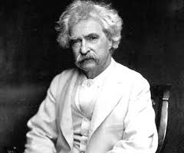
Major Writers: The Frontier (1865-1915)
Mark Twain (1835-1910)
Samuel Langhorne Clemens (His Alias)
Widely thought to be the greatest American humorist
Used vernacular (ordinary dialect), exaggeration, deadpan (expressionless) narrator to create humor
Major works
“Celebrated Jumping Frog of Calaveras Country” (tall tale)
The Adventures of Tom Sawyer
The Adventures of Huckleberry Finn

Slide 9
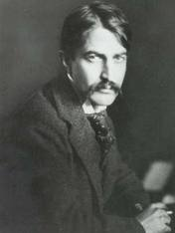
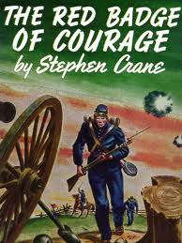
Major Writers: The Frontier (1865-1915)
Stephen Crane (1871-1900) (Naturalist)
Attacked patriotism, individualism, and organized religion
Confronted the meaninglessness of the world
Crane’s writing known for its images and symbolism
Red Badge of Courage (most famous work; set in the Civil War)
“The Open Boat” (man vs. Nature’s indifference)
“An Episode of War”

Slide 10
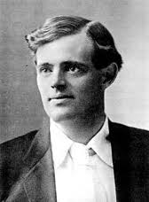
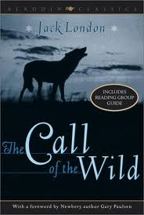
Major Writers: The Frontier (1865-1915)
Jack London (1876-1916)(Naturalist)
Pushed Naturalism to its limits
Call of the Wild (tame dog forced to revert to his original primitive state)
“To Build a Fire” (survival of the fittest)

Slide 11
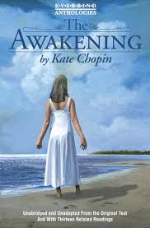
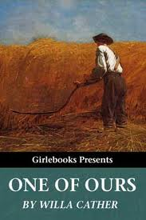
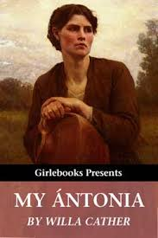
Major Writers: The Local Colorists (1865-1930) (Painted specific portraits of American regions)
Willa Cather (1873-1947)
Life of the Nebraska prairie
Won Pulitzer Prize
Kate Chopin (1851-1904)
The Louisiana Bayou
The Awakening

